Slide 1
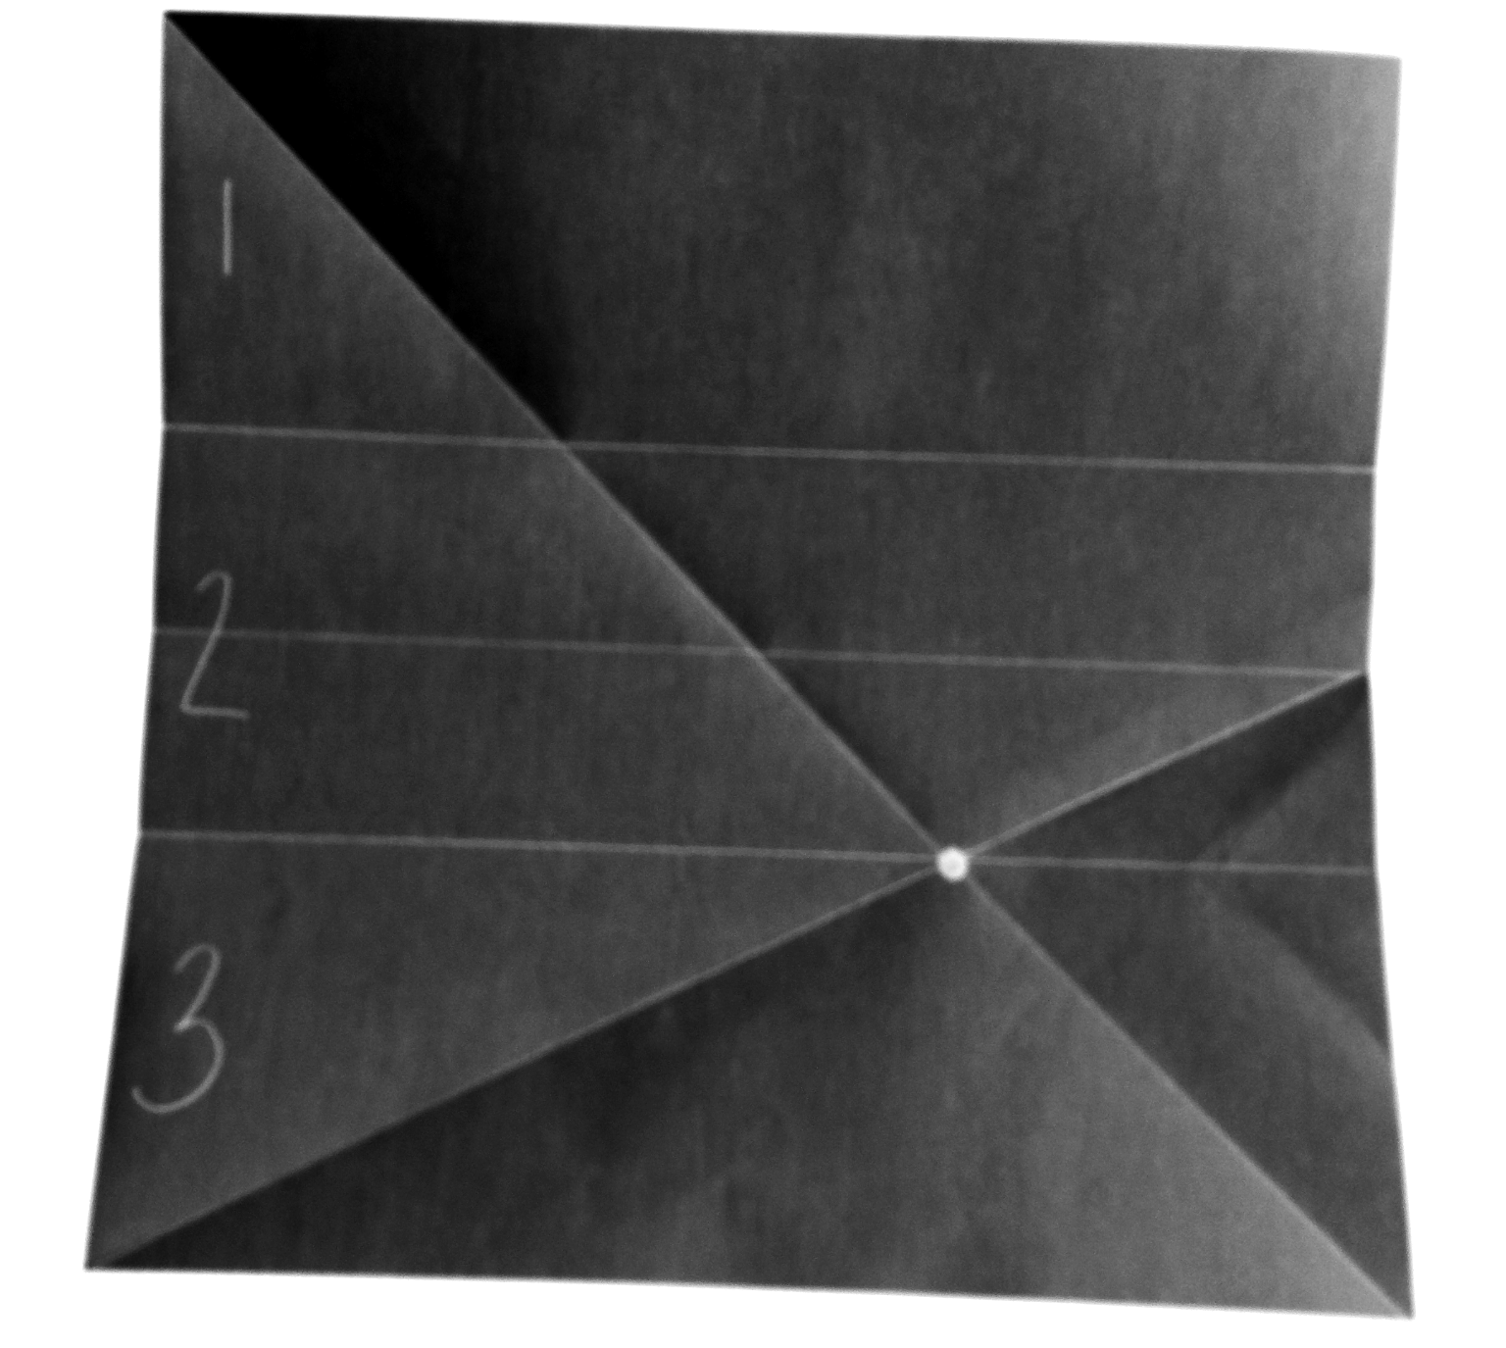
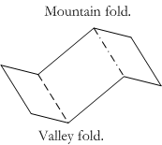
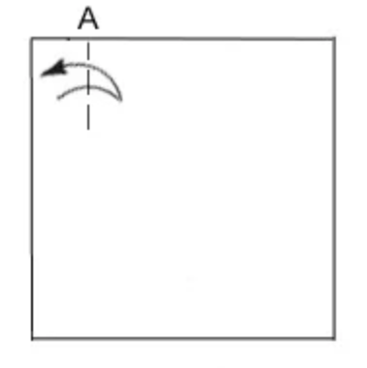
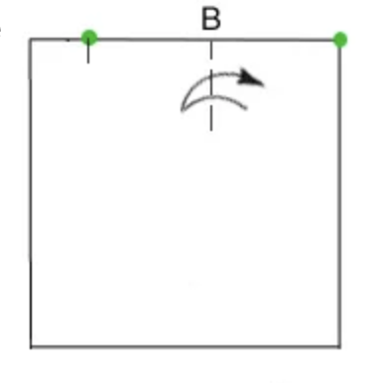
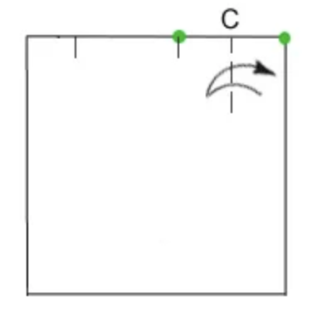
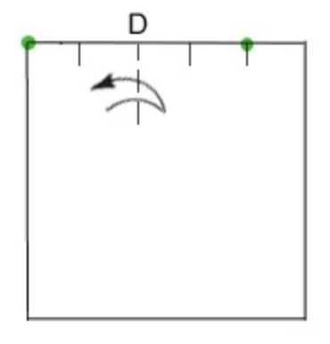
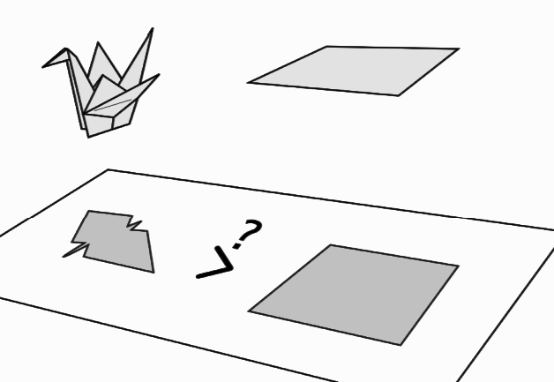
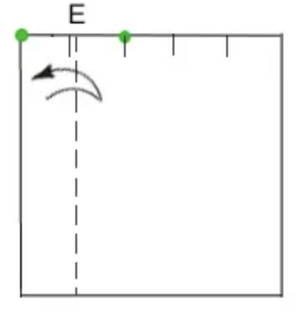
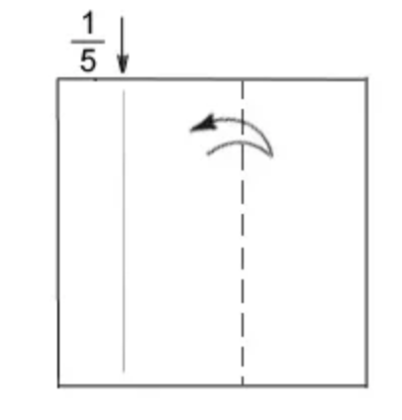
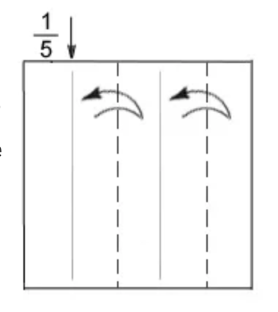
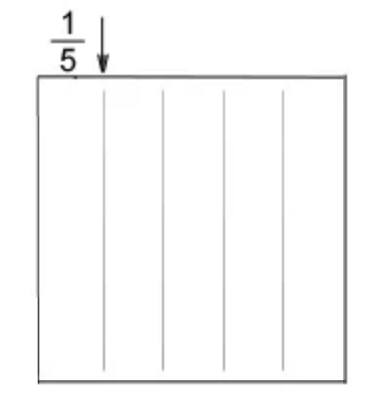
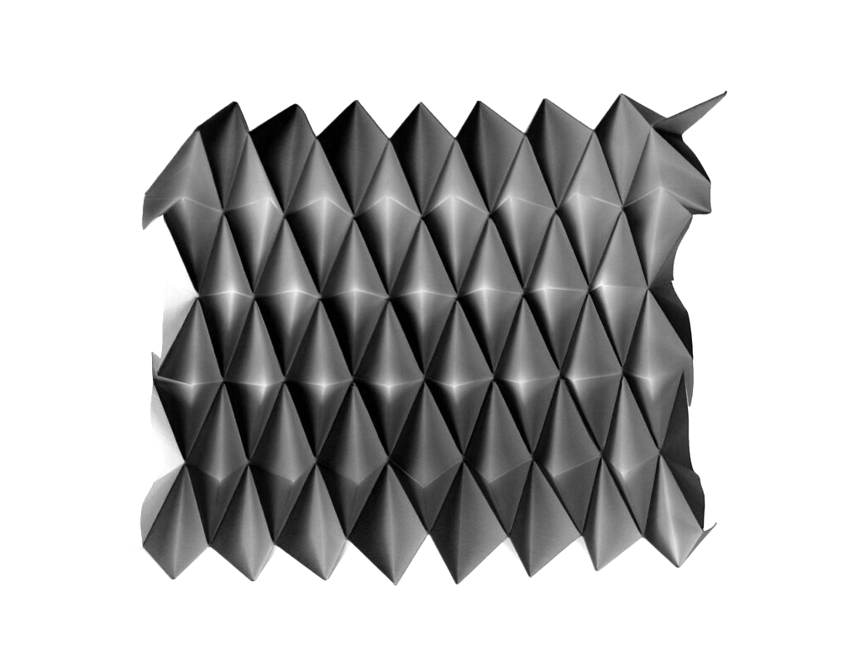
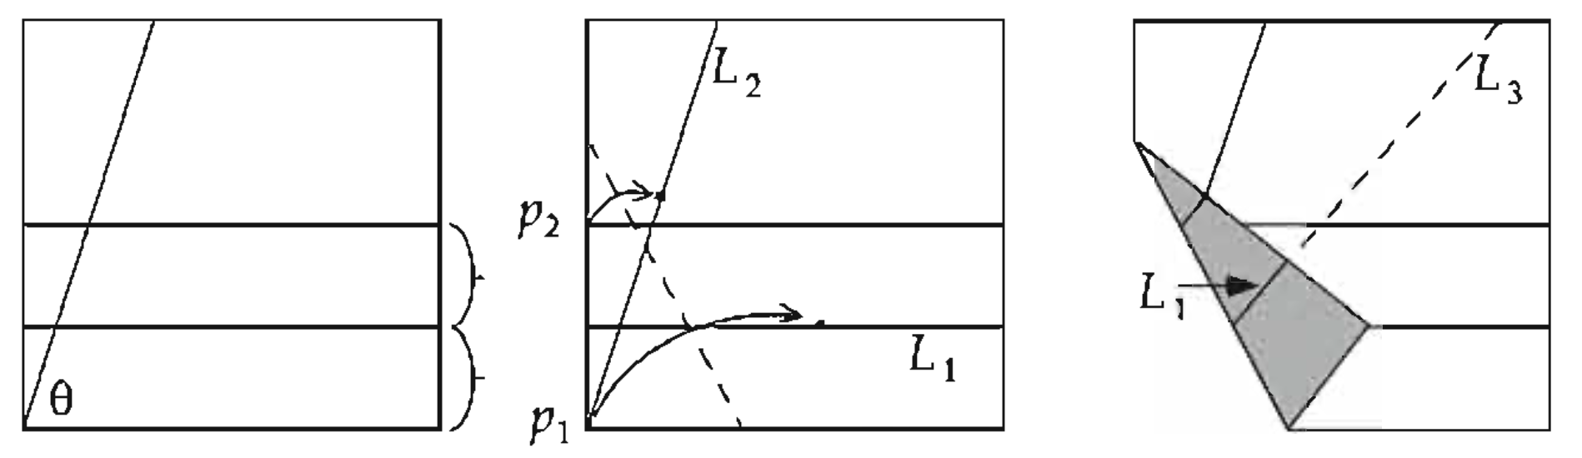
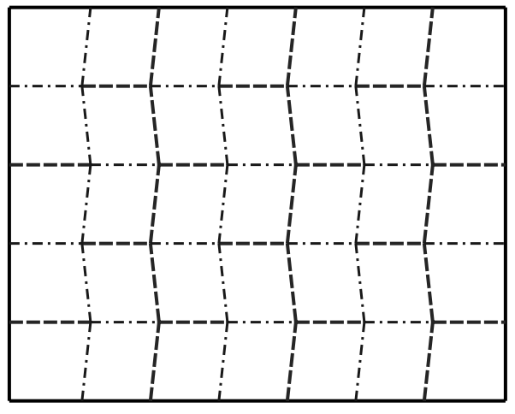
Origami and its Applications By Ryan Y. Batubara
Akira Yoshizawa: “The possibility of creation from paper is infinite”
Fujimoto Approximation (Sequences)
You could do a similar to trisect a sheet of paper.
(Surprisingly useful in folding letters into envelopes).
Now, does the below make perfect fifths of the page?
Experiment with the orange paper.
Make pinch A at approximately ⅕ of the page from the left.
Fold the right corner to A, making pinch B.
Fold the right corner to B, making pinch C.
Fold the left corner to C, making pinch D.
Fold the left corner to D, making pinch E.
Since E is ⅕ of the page, fold the remaining into halves.
Can a similar construction be done to split a page into any nths?
1
2
On Origami (折り紙)
Origami is the Japanese art of paper folding. Here,
creases refer to folds essential to a model, opposed
to any fold which may only be used as reference.
Thus, each model corresponds to a unique crease
pattern, the crease marks left when you unfold the
model, up to the kind of fold, as shown right:
3
Napkin Folding Problem (Geometry)
Define maximum perimeter as the
largest 2D-perimeter you can measure
by projecting a model onto the plane in
any direction. Thus, the unit square has
maximum perimeter of 4, as shown.
Can you fold a unit square in such a way that the model’s maximum perimeter is greater than 4? Experiment with the pink paper.
Impossible Trisections (Algebra and Geometry)
It is impossible to trisect an angle using just a ruler and compass.
Proof sketch: Trisecting 60° is equivalent to computing cos(π/9), which satisfies an irreducible polynomial of degree 3. Since the only numbers that can be produced ruler-and-compass have power of two algebraic degrees, trisection is impossible.
Follow the below construction. What happened?
Modular Origami & Miura Map Fold (3D Geometry)
Rigid origami, where sheets cannot be bent and edges behave as hinges, has gained recent popularity in compacting solar panels for spacecraft and satellites. The Miura Map Fold is a famous example used in the Space Flyer Unit, a 1996 Japanese satellite.
Activities, proofs, and illustrations inspired/taken from:
“Project Origami: Activities for Exploring Mathematics” by Thomas Hull in 2006
“Origami Design Secrets” second edition by Robert Lang in 2012
“Twists, Tilings, and Tessellations” by Robert Lang in 2018
ANSWERS:
Napkin Problem: Yes, and as large as we want given infinitely thin paper.
Impossible Trisections: We trisected, meaning we can solve cubics with origami!
Fujimoto: Perfect iff ∞ iterations; Yes, fold out 2s, then apply general Fujimoto.
Page 1

Slide 2
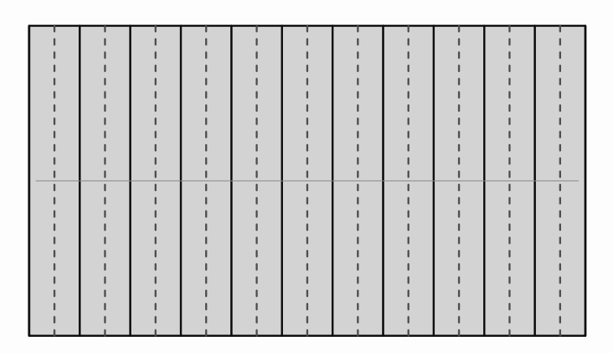
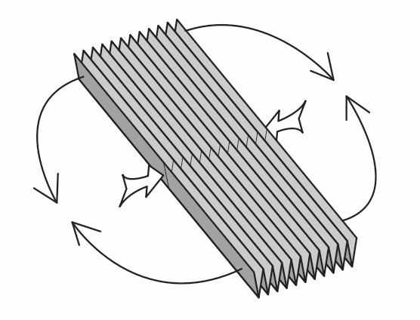
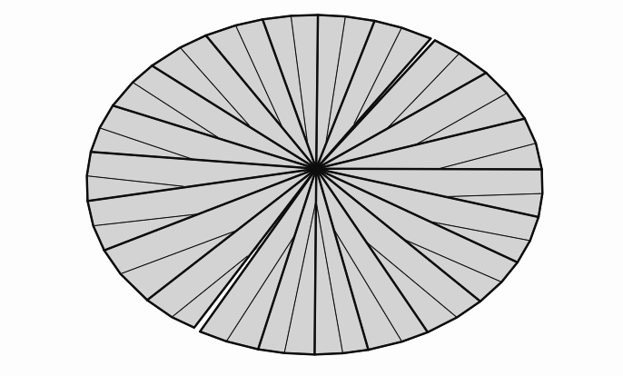
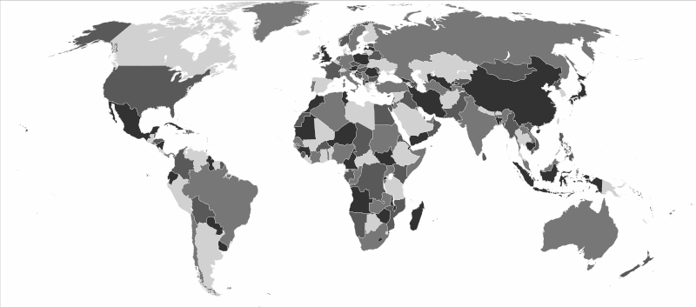
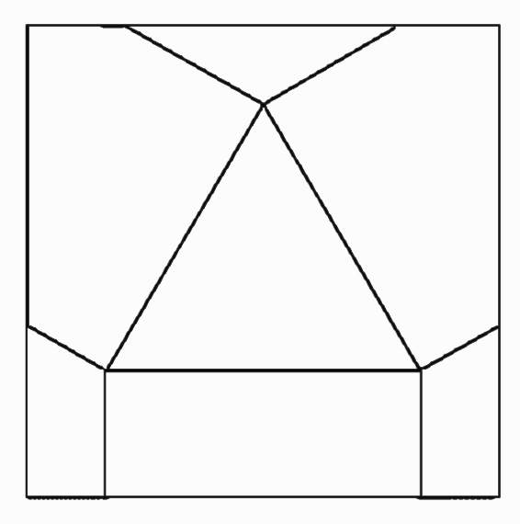
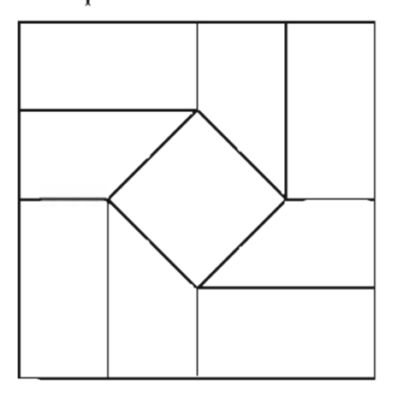
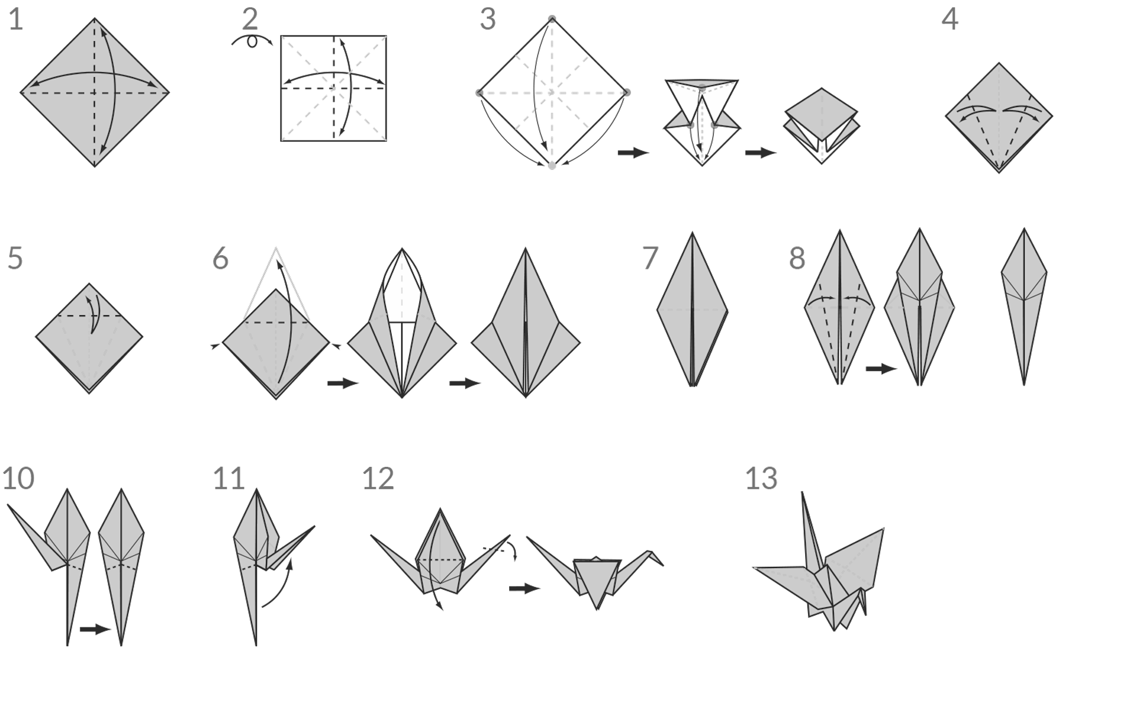
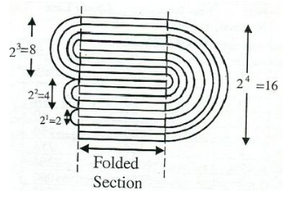
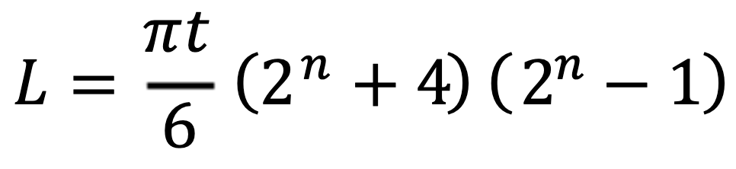
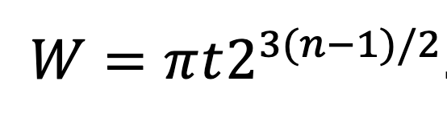
Impossible Folds (Geometry)
Some folds (iterated ∞ times) make seemingly impossible flat shapes:
But are some folds impossible? The right pattern is
impossible to make flat! Why?
Big-Little-Big Lemma: Given consecutive angles a,b,c around a flat
vertex pattern with a>b, b<c then the creases between these angles
cannot have same mountain-valley parity (else paper intersects).
Coloring Cranes (Graph Theory)
The famous Four Color Theorem states at most 4 colors are needed to color any map so that no two adjacent regions have the same color:
Fold a crane with the yellow paper, then unfolding it to form a crease pattern. Shade the faces of the pattern. How many colors did it take? Now, fold the crane back up, where the grey side of the paper is the side you shaded; the final product has no yellow. What do you notice?
This result gives a very fast way for a computer to check the direction in which a flat origami crease pattern will face when folded. Thus it is a powerful shortcut in computational origami.
Flat-Foldability (Geometry and Combinatorics)
There are a finite number of theorems that can tell us whether a single vertex crease pattern is flat-foldable. However, it is NP-hard to determine if multi-vertex patterns are flat foldable, and it remains an open problem what the sufficiency conditions are to be flat-foldable!
Enumerating Folds (Graph Theory)
How many different models you can make with
this crease pattern? Experiment on the blue paper.
(Try different combinations of mountains/valleys).
Maekawa-Justin: The number of valley (V) and mountain (M) folds in a single vertex must differ by 2, i.e. |M - V| = 2. (How does this relate to Euler’s V - E + F = 2?)
Physical Limitations (Physics)
Paper is not infinitely thin; In 2002, Britney Gallivan derived a formula for this, and broke the Guiness record by folding toilet paper 12 times.
L is length, W is width, n is folds, t is thickness
Activities, proofs, and illustrations inspired/taken from:
“Project Origami: Activities for Exploring Mathematics” by Thomas Hull in 2006
“Origami Design Secrets” second edition by Robert Lang in 2012
“Twists, Tilings, and Tessellations” by Robert Lang in 2018
ANSWERS:
Impossible Folds: By lemma, triangle requires alternating mountain-valley.
Enumerating Folds: There are 6, by repeated application of the theorem.
Coloring Cranes: All origami (even 3D models) are two-face-colorable.
Page 2

